Slide 1

CBD-3335
Coursera Course Recommendation Engine
Instructor: Mohammad Islam
Group Members:
Ananya Singh(C0800598)
Jacob Sebastian(C0806499)
Prachi Shah(C0820195)
Sreeraj Sudhakaran(C0805420)

Slide 2
Problem Use Case
Performing Sentiment Analysis on reviews scrapped from Coursera.
Validating our model based on star ratings given by users.
Finding top 5 and bottom 5 courses for each subject based on the ratio of positive, negative reviews.

Slide 3

Steps involved in the process
Data Extraction
Data Cleaning
Data Preprocessing
Data Visualization
Sentiment Analysis
Model Evaluation

Slide 4
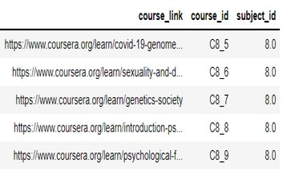
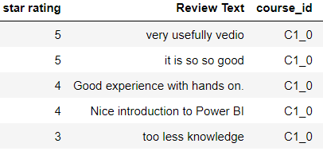
Data Extraction
Using Selenium, first scrapped all the courses links for 7 different domains
Fetched all the reviews, star ratings for each courses and assigned unique ID to each course.
Collected total 65879 reviews.

Slide 5
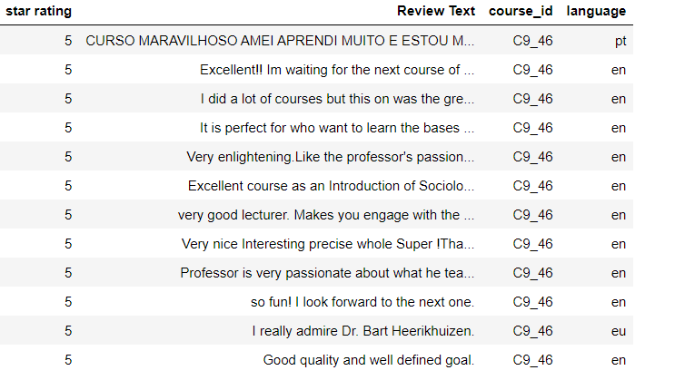
Language Detection
- Some reviews are written in different language
- Using TextBlob we identified the language for each review
- We tried translating Non English reviews into English, but with google translator we exceeded the free tier limit.
- For further analysis we have used reviews written in English.

Slide 6
Data Cleaning
Converted all textual data into lower case.
Using regex, we removed all non-alpha characters such as special characters, extra spaces, numbers, emoji, etc.
Used SymSpellPy to convert each token into the appropriate English word.
Removed Stopped words
Lemmatization to convert the word into its original form using the POS tag.

Slide 7
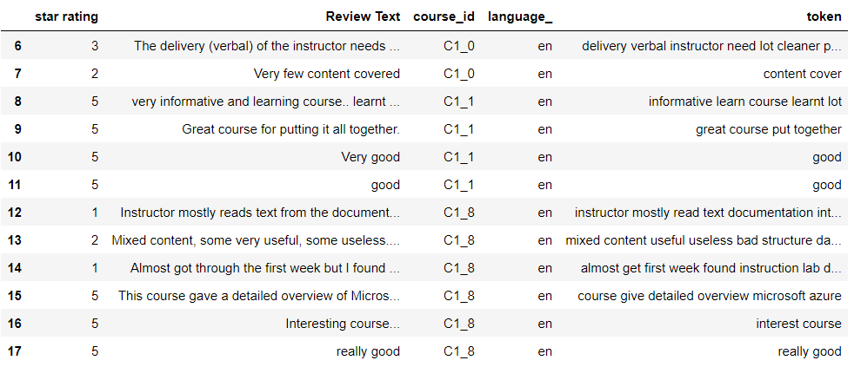
Data Cleaning

Slide 8
Data Preprocessing
We converted star ratings into positive, neutral and negative
Ratings > 3 (Positive, 1)
Ratings = 3 (Neutral, 0)
Ratings < 3 (Negative, -1)
To convert textual data into vectors we used TF-IDF concept, which converted all tokens into numeric value.

Slide 9
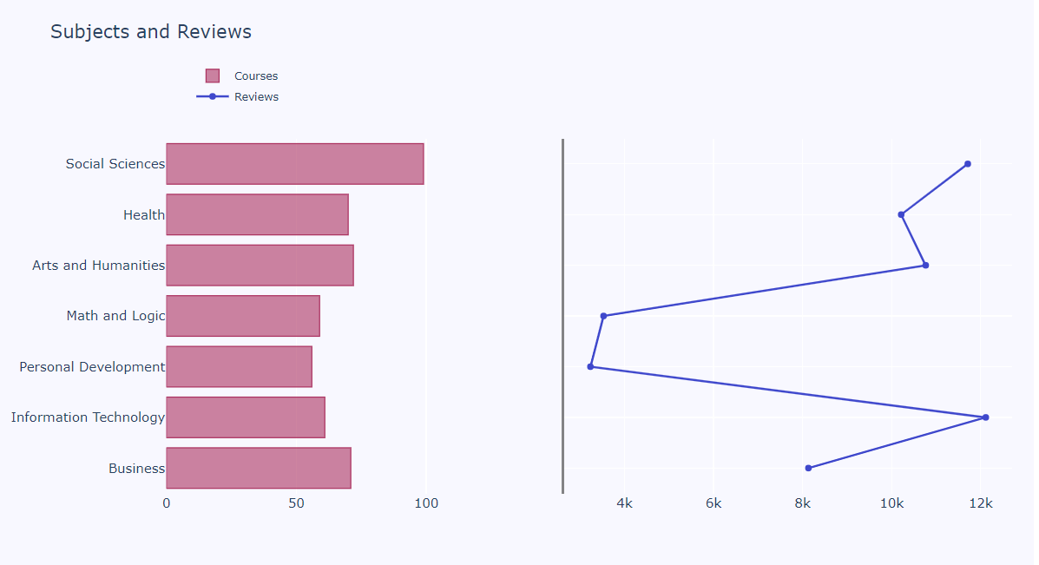
Data Visualization
Plotted number of courses for each subject in horizontal bar charts and total number of reviews for each subject in line charts.

Slide 10
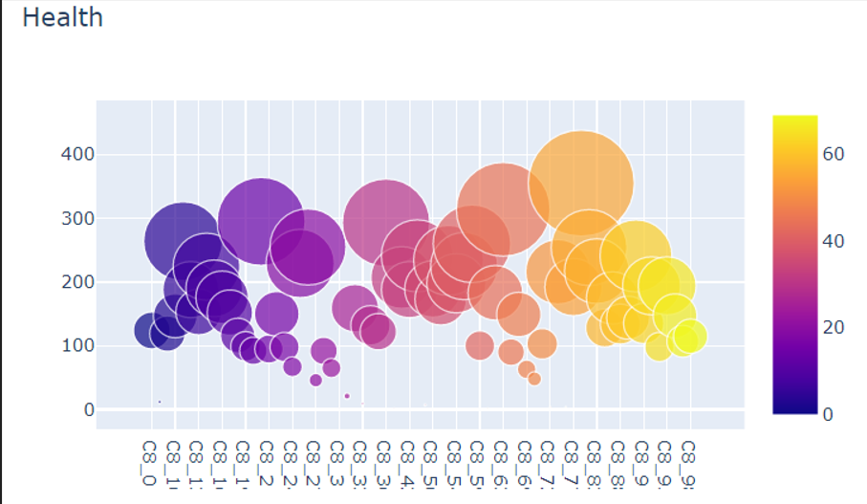
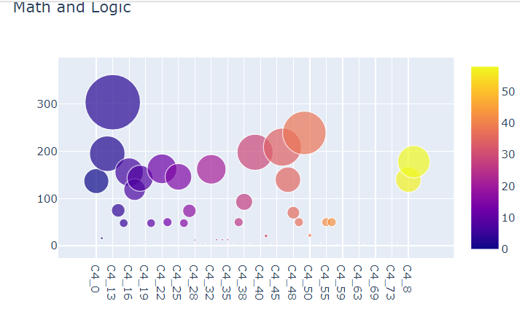
Data Visualization
Plotted the number of reviews for each courses, size of bubble is equivalent to count of reviews.

Slide 11
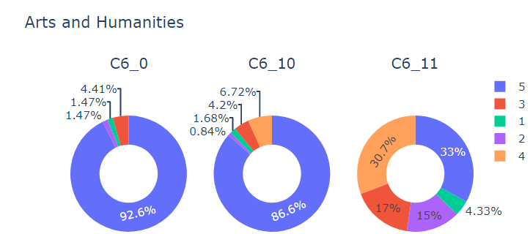
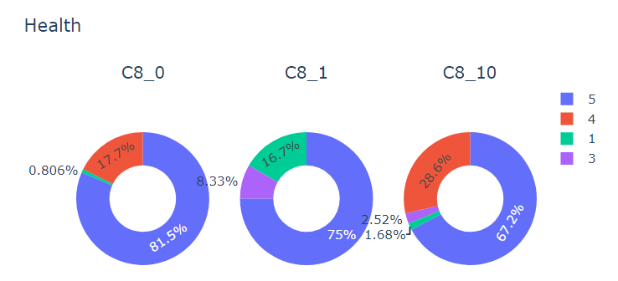
Data Visualization
Percentage of positive, neutral, and negative reviews for each course.

Slide 12
Sentiment Analysis
We Split the data set into train & test datasets in the ratio 70:30 respectively
4 Classification models used for prediction
Logistic Regression
KNN classifier
Random Forest
Gaussian Naïve Bayes

Slide 13
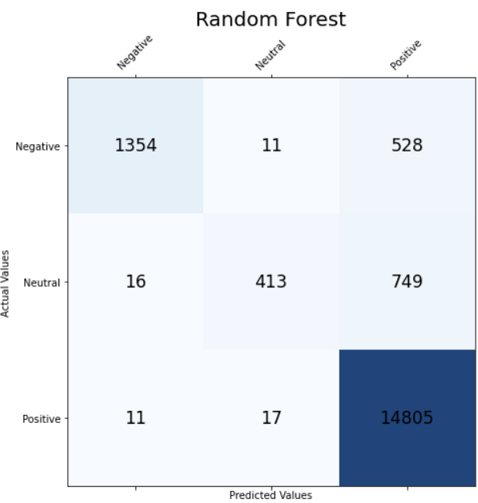
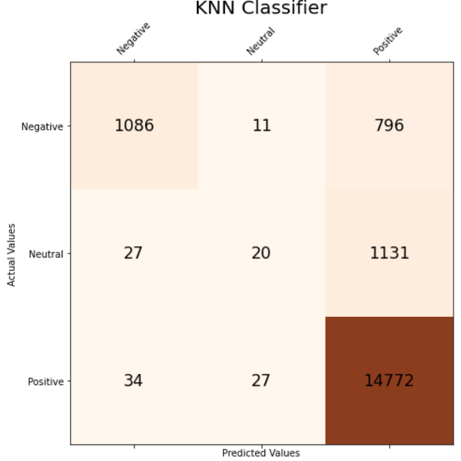
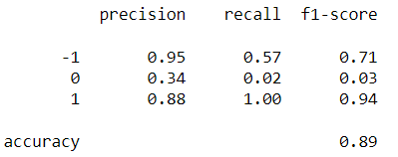
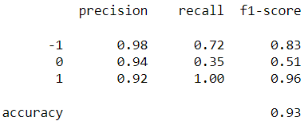
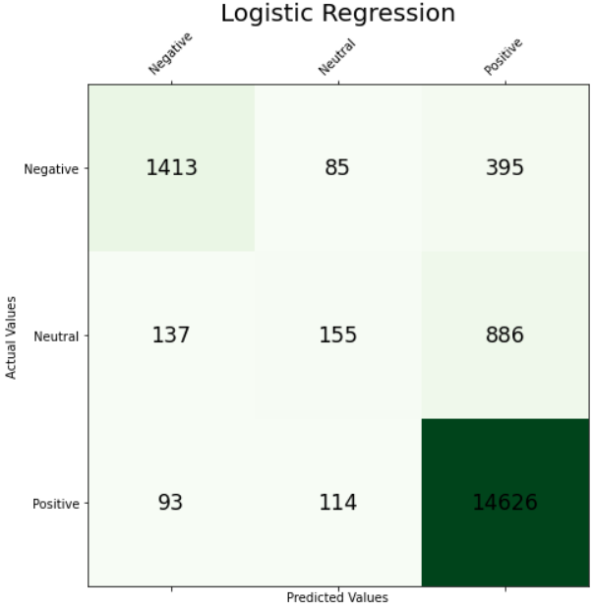
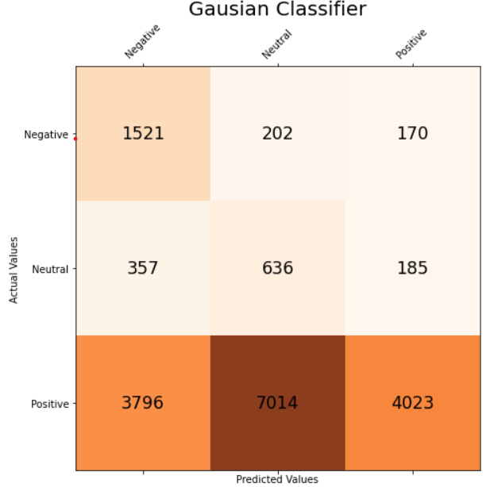
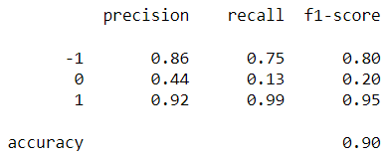
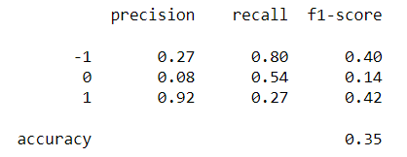
Model Evaluation

Slide 14
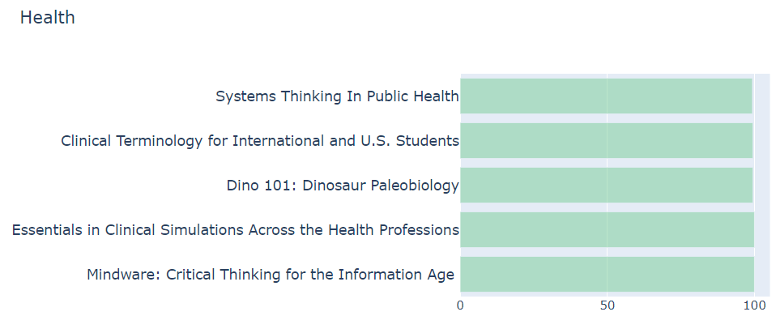
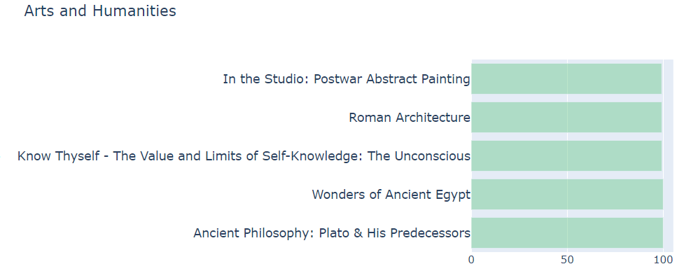
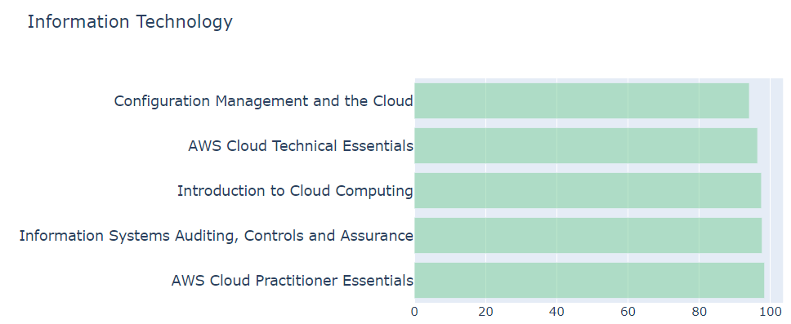
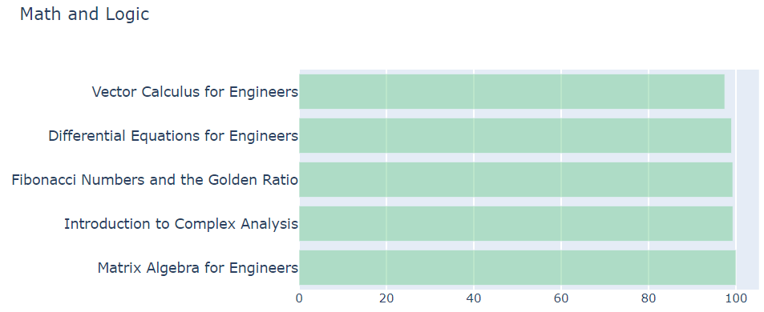
Most favorable Courses for each subject

Slide 15
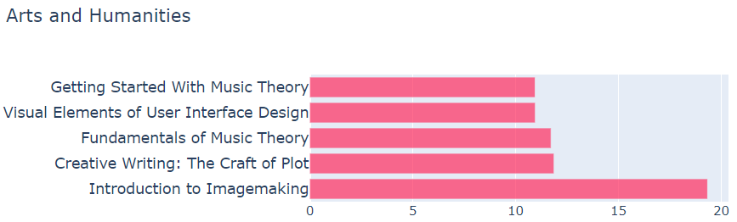
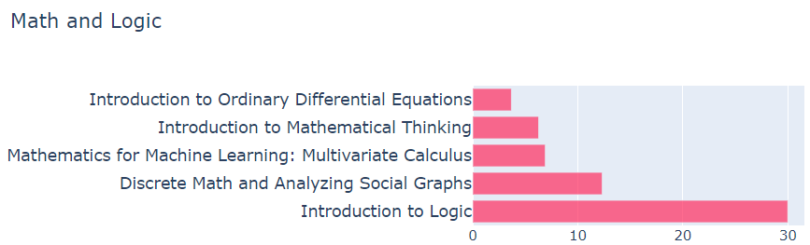
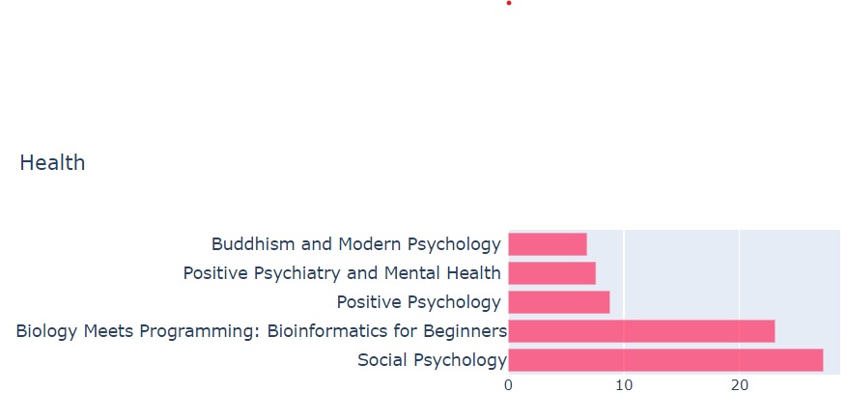
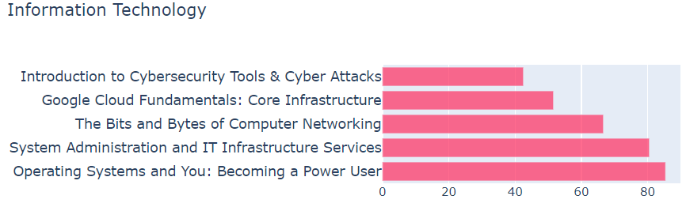
Least favorable Courses for each subject

Slide 16
Conclusion
We tried performing sentiment analysis on data scrapped from Coursera.
We applied supervised learning and tried 4 different classification model, out of which Random Forest performed the best.
Saved our trained model in pickle file which we can use for further prediction.

Slide 17
References
Sahin, K. (n.d.). Web Scraping using Selenium and Python. Www.scrapingbee.com. https://www.scrapingbee.com/blog/selenium-python/
Plotly Python Graphing Library. (n.d.). Plotly.com. https://plotly.com/python/
Sentiment Analysis with Python - A Beginner’s Guide - AlgoTrading101 Blog. (2019, December 13). https://algotrading101.com/learn/sentiment-analysis-python-guide/
‌How to Translate Languages in Python? [A Complete Guide]. (2021, January 31). TechGeekBuzz. https://www.techgeekbuzz.com/how-to-translate-languages-in-python/

Slide 18


